Slide 1

Skill Graph:A Personalized Learning Path Recommendation System Using Web Technologies
Team Details
1. M.RISHA REDDY(22EG105G34)
2. V.SAI ROHAN(22EG105G56)
3. M.TARUNI REDDY(22EG105G33)
4. A.MANI VARDHAN LAL(23EG105G06)
Project Guide
Dr..Kamalakar Ramineni
Assistant Professor
Department of CSE
21.01.2026
Department of Computer Science and Engineering
‹#›

Slide 2
Introduction
Digital Learning presently faces certain problems, such as fragmented learning resources that contribute to "information overload," which makes finding a clear path to professional mastery difficult for learners. In this regard, the Skill Graph project introduces an intelligent web-based recommendation system that utilizes Graph Theory to model the technical landscape. The system represents distinct skills as nodes and their prerequisite dependencies as directed edges to construct a comprehensive "Knowledge Graph" of professional domains.
It analyzes the user's current skill level and uses personalized pathfinding algorithms to curate a bespoke, step-by-step learning roadmap toward a career goal, such as Data Scientist or Full-Stack Developer. By integrating modern web technologies and interactive visualizations, the system simplifies complex hierarchies of skills and offers a dynamic framework for real-time tracking of progress. This may serve as a massive game-changer for e-learning platforms with automated course sequencing, corporate upskilling efforts, and data-driven guidance for students into the competitive tech industry.
21.01.2026
Department of Computer Science and Engineering
‹#›

Slide 3
Problem Statement
A critical examination of contemporary educational platforms uncovers an inherent limitation at the core of the structure in how they arrange and deliver learning content. The majority of these platforms rely on linear content progression and static course listings, which do not reflect the complex, interdependent relationships among technical skills. This overly simplified structure often places learners in fragmented learning paths, leading to the phenomenon of information overload where users spend time on repetitive topics while essential prerequisites are inadvertently neglected. These inefficiencies result in confusion, partial knowledge acquisition, and slower professional development. The proposed initiative addresses these issues by developing an advanced Skill Graph, based learning model that represents a Directed Acyclic Graph (DAG) with the Neo4j graph database. Here, each skill is a node, and the prerequisite relationships are the directed edges, thus providing a precise and structured representation of knowledge dependencies. Neo4js feature of handling relationship, intensive data in an efficient manner is what makes logical learning progression possible and the problem of circular dependencies is resolved. Besides this, the platform also has an intelligent recommendation system accessible through the web, which determines the learner's proficiency and career objectives. It conducts the gap analysis automatically, and the pathfinding algorithms help to create a personalized step, by, step career roadmap. The progress comes out much clearer with the help of interactive visualizations that make tracking easier for learners.
21.01.2026
Department of Computer Science and Engineering
‹#›

Slide 4
Abstract
The exponential increase in digital educational platforms has led to a vast pool of learning materials, which are mostly delivered through linear and static content frameworks. These methods do not mirror the complex interrelations of the technical skills and thus lead to fragmented learning, information overload, and slow knowledge acquisition. It is a common occurrence that learners are stuck in repetitive topics or do not get essential prerequisites, leading to conceptual gaps and deferred professional development. This project aims to overcome such a drawback by the implementation of a personalized learning path recommendation system that uses a Skill Graph and is based on Graph Theory principles. The system identifies the technical skills as nodes and the prerequisite relations as directed edges in a Directed Acyclic Graph (DAG) which is kept in the Neo4j graph database that is designed to relationship, intensive data handling. Considering a learner's existing skill set and career goals, the system carries out an automatic gap analysis and also performs the efficient pathfinding algorithms in order to produce the personalized stepwise learning roadmap. The system also offers interactive visualization through the web to attract the user and allow him/her to keep track of their progress in real, time. This data, informed framework guarantees a reasonable sequence of learning, the avoidance of circular dependencies, and reduction of cognitive overload. In the end, the suggested model gives a different, less time, consuming, and more structurally sound way for learners to acquire professional mastery with the help of traditional learning methods.
21.01.2026
Department of Computer Science and Engineering
‹#›

Slide 5
Literature Survey
Author(s) | Method | Advantages | Disadvantages
Chen et al. | Dijkstra-based Pathfinding | Finds the mathematically shortest learning route. | Often ignores the "difficulty" of a specific skill.
S. Smith | D3.js Visualizations | Highly intuitive and interactive user interface. | Performance lags with very large datasets.
IEEE Survey | Collaborative Filtering | Recommends paths based on other successful learners. | The "Cold Start" problem for brand-new users.
J. Guo et al. | Knowledge Graph–Based Recommendation System | Captures complex skill dependencies & enables highly personalized learning paths using semantic relationships. | Requires extensive data modeling and high computational resources for large-scale graphs.
L. Ma et al. (Applied Sciences, 2023) | Hybrid Learning Path Recommendation | Improves recommendation accuracy by combining multiple algorithms and learner behavior analysis. | Increased system complexity and longer training time for model optimization.
21.01.2026
Department of Computer Science and Engineering
‹#›

Slide 6
Objectives
  Construct a Knowledge Graph Architecture: To design and implement a Directed Acyclic Graph (DAG) using the Neo4j database, mapping technical skills as nodes and their prerequisite dependencies as directed edges to create a structured skill ecosystem.
  Develop an Intelligent Recommendation Engine: To build a backend system that utilizes pathfinding algorithms (such as Dijkstra’s or BFS) to perform automated gap analysis and generate a personalized, step- by-step learning roadmap based on a user’s unique profile.
  Create an Interactive Web Visualization Dashboard: To develop a dynamic frontend using web technologies (React and D3.js/Cytoscape.js) that provides users with a visual, "GPS-like" interface to explore their career path and track learning progress in real-time.
  Optimize the Learning Experience: To streamline professional mastery by eliminating "Information Overload" and educational redundancy, ensuring users follow the most efficient and logical sequence of skill acquisition for their specific career goals.
21.01.2026
Department of Computer Science and Engineering
‹#›

Slide 7
Methodology
  Data Collection & Modeling:
    Scraping job descriptions and course syllabi to define skill nodes. Establishing "Requires" and "Leads To" relationships.
    Storing data in a Graph Database (Neo4j) for efficient querying.
  User Profiling:
    A skill assessment module where users input their current proficiency. The system marks "Completed" nodes in the graph based on user input.
  The Recommendation Algorithm:
    Implementation of BFS (Breadth-First Search) to find the logical sequence. Ranking resources (Videos/Articles) for each specific skill node.
  Web Visualization:
    Using D3.js to render an interactive map.
    Color-coding: Green (Learned), Yellow (In-Progress), Red (To-Learn).
21.01.2026
Department of Computer Science and Engineering
‹#›

Slide 8
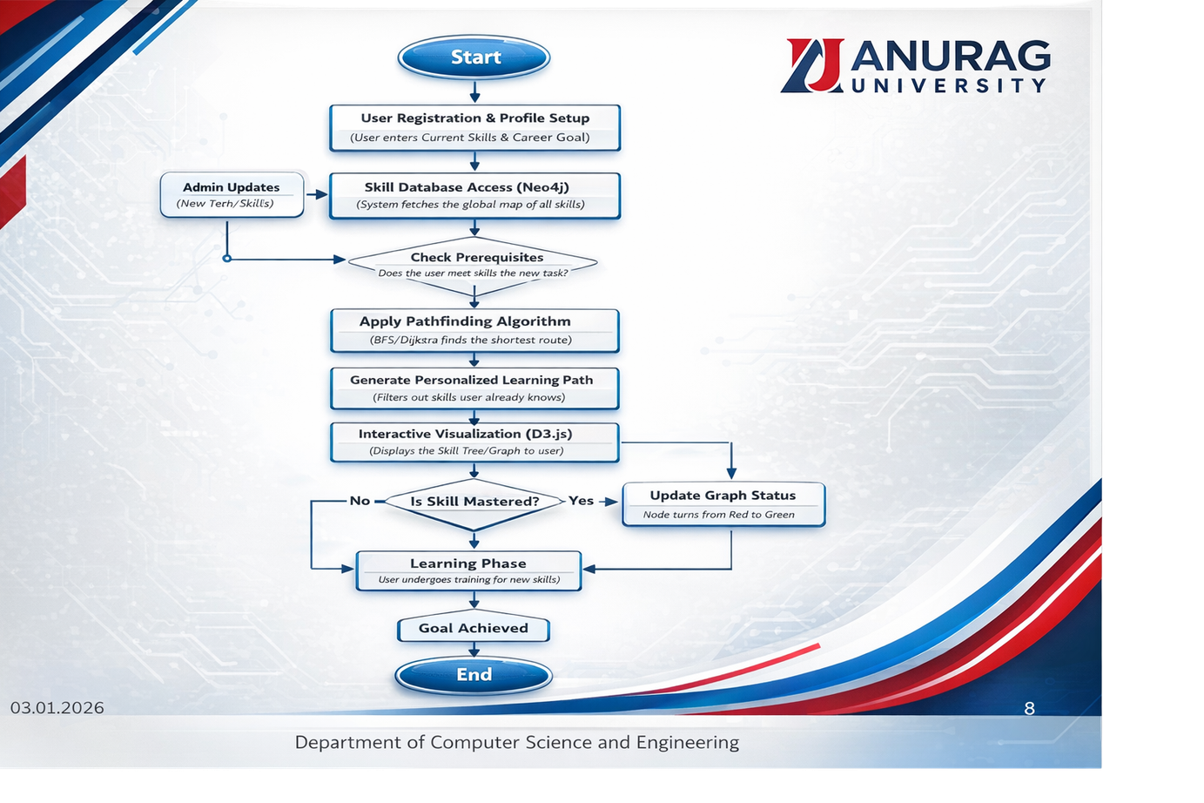
21.01.2026
Department of Computer Science and Engineering
‹#›

Slide 9
References
  J. Guo, Y. Wang, S. Wu, W. Yang, and Q. Li, "A Survey on Knowledge Graph-Based Recommender Systems," IEEE Transactions on Knowledge and Data Engineering, vol. 34, no. 8,
  pp. 3522-3543, Aug. 2022. [IEEE]
  L. Ma, X. Li, and Y. Wang, "Personalized Learning Path Recommendation Method Incorporating Multi-Algorithm," Applied Sciences, vol. 13, no. 10, pp. 5946-5962, May 2023. [MDPI]
  Y. Chen, Y. Liu, and H. Cheng, "Construction of Knowledge Graph for Personalized Learning Recommendation," Journal of Physics: Conference Series, vol. 1651, no. 1, pp. 012115-012125, Oct. 2020. [IOP]
  B. Meissner and M. Köbis, "Annotated Knowledge Graphs for Teaching in Higher Education," International Conference on Web Engineering, vol. 12111, pp. 581-588, Jun. 2020. [Springer]
21.01.2026
Department of Computer Science and Engineering
10

Slide 10
UML Diagrams
21.01.2026
Department of Computer Science and Engineering

Slide 11
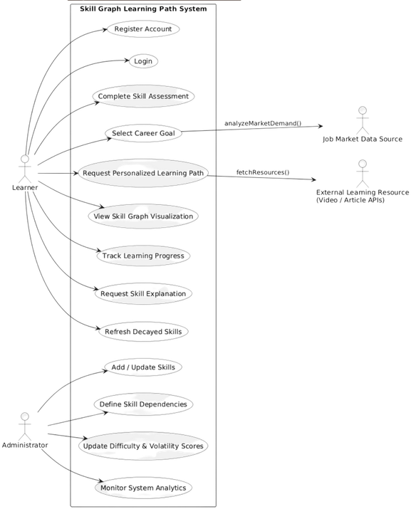
USECASE DIAGRAM
  Represents functional behavior of the system
  Shows interaction between actors and system features
  Actors involved:
    Learner (User)
    Administrator (Admin)
    External APIs (Resources / Job Data)
  Learner functionalities:
    Register & Login
    Enter current skills
    Select career goals
    View skill graph
    Get personalized learning path
    Track learning progress
  Admin functionalities:
    Add / update skills
    Define skill dependencies
    Maintain skill graph
  Helps in requirement analysis and system understanding
21.01.2026
Department of Computer Science and Engineering

Slide 12
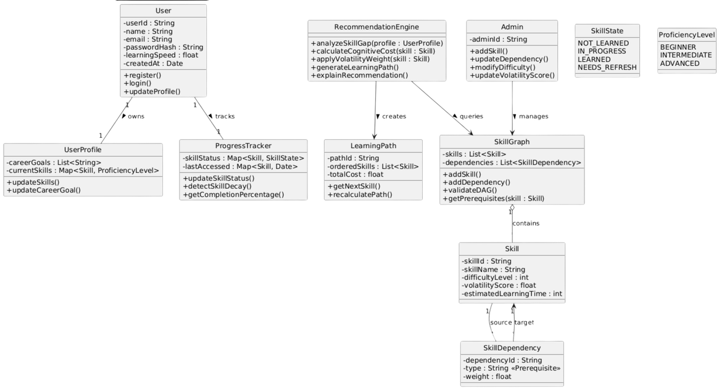
CLASS DIAGRAM
  Represents the static structure of the system
  Shows classes, attributes, methods, and relationship
Main classes used:
  User & UserProfile
  Skill & SkillDependency
  SkillGraph
  RecommendationEngine
  LearningPath
  ProgressTracker
  Admin
Key relationships:
  User owns a UserProfile and ProgressTracker
  SkillGraph contains multiple Skills
  RecommendationEngine generates LearningPath
  Admin manages SkillGraph
  Helps in understanding data flow and system design
21.01.2026
Department of Computer Science and Engineering

Slide 13
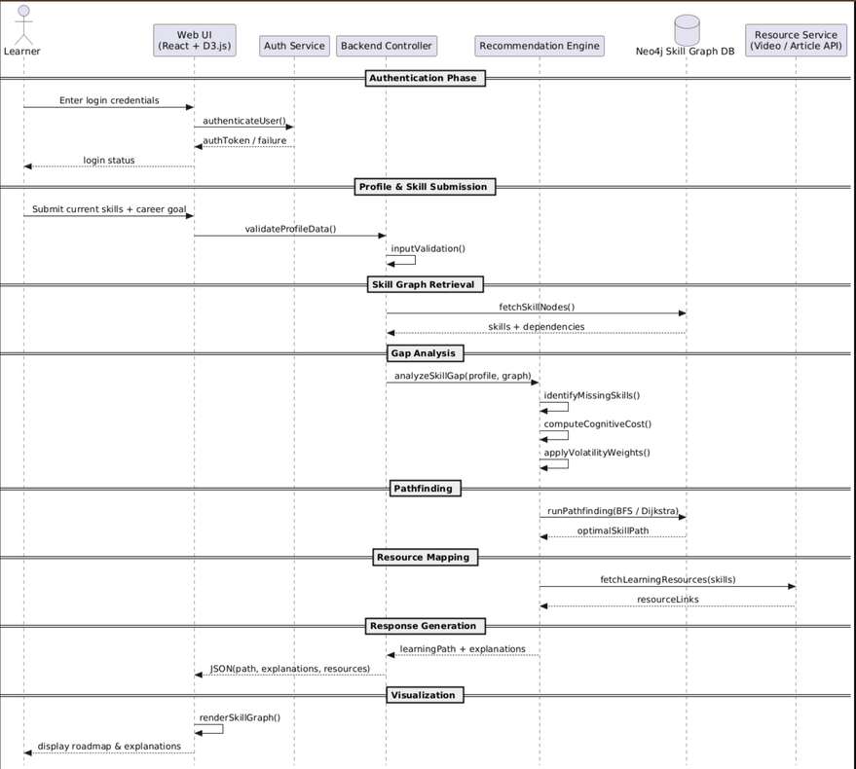
SEQUENCE DIAGRAM
  Represents the interaction flow over time
  Shows order of messages between system components
  Helps in understanding runtime behavior
Main participants:
  User
  Web UI
  Backend Server
  Recommendation Engine
  Skill Graph Database (Neo4j)
Sequence flow:
  User submits skills and career goal
  Backend validates input and fetches skill graph
  Recommendation engine performs gap analysis
  Pathfinding algorithm generates learning path
  Result is returned and displayed to the user
21.01.2026
Department of Computer Science and Engineering

Slide 14
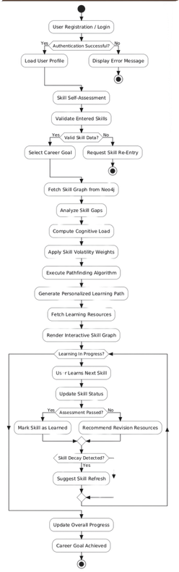
ACTIVITY DIAGRAM
  Represents the workflow of the system
  Shows step-by-step activities and decisions
  Includes decision points and loops
  Helps in understanding overall process flow
Major activities include:
  User login and profile setup
  Skill assessment and career goal selection
  Skill gap analysis
  Learning path generation
  Skill graph visualization
  Learning and progress tracking
21.01.2026
Department of Computer Science and Engineering

Slide 15
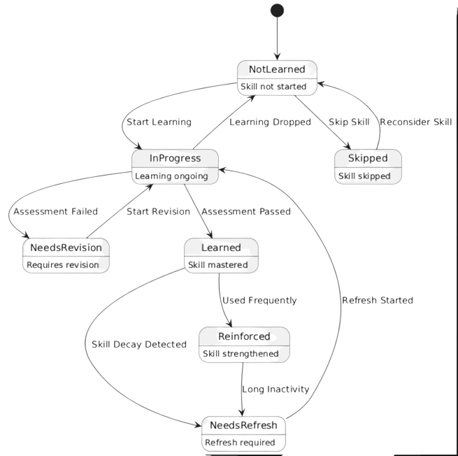
STATE DIAGRAM
  Represents different states of a skill
  Shows state transitions based on user actions
  Key states include:
    Not Learned
    In Progress
    Learned
    Needs Revision
    Needs Refresh
  Transitions occur due to:
    Learning start
    Assessment result
    Skill decay
    Revision or refresh action
  Helps in modeling skill lifecycle behavior
21.01.2026
Department of Computer Science and Engineering

Slide 16
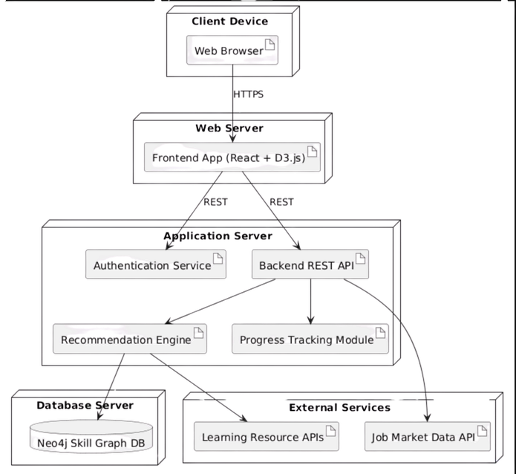
DEPLOYMENT DIAGRAM
Purpose
  Represents the physical architecture of the system
  Shows where software components are deployed and how they communicate at runtime
Key Elements
  Client Device: Web browser used by learners
  Web Server: Hosts frontend UI (React + D3.js)
  Application Server:
    Authentication Service
    Backend REST API
    Recommendation Engine
    Progress Tracking Module
  Database Server: Neo4j Graph Database
  External Services: Learning resource APIs & job market data APIs
Communication
  Client ↔ Web Server: HTTPS
  Frontend ↔ Backend: REST APIs
  Backend ↔ Database: Graph queries
Significance
  Ensures scalability, security, and modular deployment
  Helps understand runtime behavior and system integration
21.01.2026
Department of Computer Science and Engineering

Slide 17
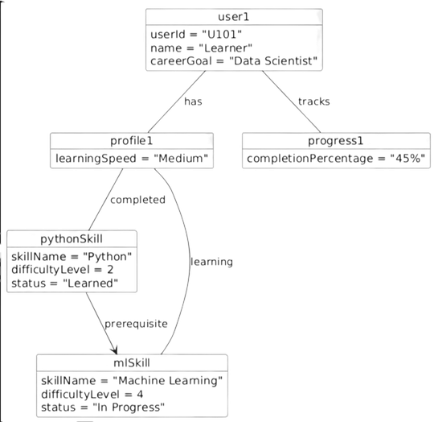
OBJECT DIAGRAM
Purpose:
  Represents a snapshot of the system at a specific point in time
  Shows real object instances and their relationships during runtime
Key Elements
  User Object: Learner with selected career goal
  Profile Object: Contains current skills and learning preferences
  Skill Objects: Instances such as Python and Machine Learning with current status
  Progress Object: Tracks completion percentage and learning state
Relationships
  User has a profile and tracks progress
  Skills are linked through prerequisite relationships
  Profile connects to skills based on learning status
Significance
  Helps visualize actual data values in the system
  Validates class diagram by showing real-time object interactions
  Useful for understanding runtime behavior and system state
21.01.2026
Department of Computer Science and Engineering

Slide 18
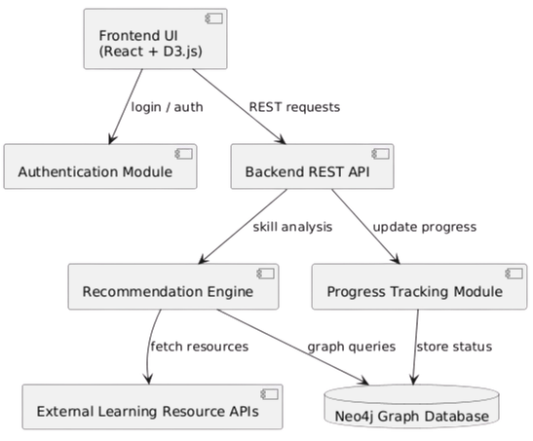
COMPONENT DIAGRAM
Purpose
  Represents the logical architecture of the system
  Shows how the system is divided into independent functional components
Key Components
  Frontend UI: User interface built using React and D3.js
  Authentication Module: Handles user login and authorization
  Backend REST API: Manages requests and system logic
  Recommendation Engine: Performs skill gap analysis and path generation
  Progress Tracking Module: Monitors learning progress and skill status
  Graph Database: Neo4j database storing skill nodes and dependencies
Interactions
  Frontend communicates with backend using REST APIs
  Backend interacts with recommendation engine for learning path generation
  Recommendation engine queries the graph database for skill dependencies
Significance
  Promotes modularity, scalability, and maintainability
  Helps in understanding component responsibilities and dependencies
21.01.2026
Department of Computer Science and Engineering

Slide 19
Thank You
03.01.2026
Department of Computer Science and Engineering
11

